Slide 1
* What is computer
- what is cpu (processor), how it works.
- what is RAM memory
- what is hard drive
- input output devices
- operating system ( how it manages resources on computer, how it executes program )
* what is program
- how the program works on computer ( interpreter, compiler )
- mental strategy
- structure of program
- tools for programming ( python )
* parts of program
- data types
- values and expression
- control structure ( if/else, conditions)
- iterations ( for, while )
- functions ( grouping instructions together)
* software development lifecycle
- plan
- development
- testing
- deployment ( launch ) final product

Slide 2
Fundamentals of Computer

Slide 3
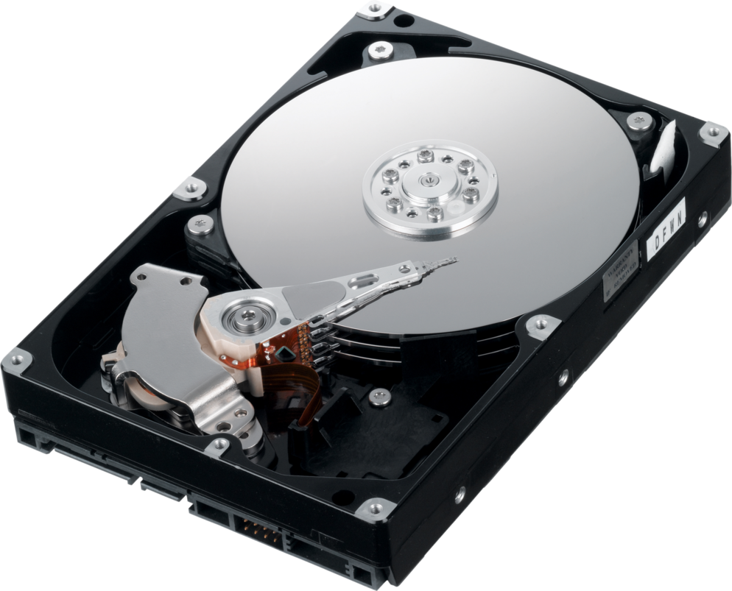
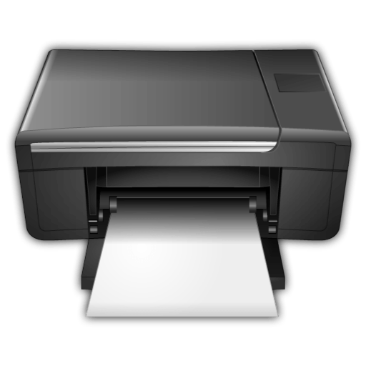
What is Computer?
Input
A computer is an electronic device that manipulates information, or data. It has the ability to store, retrieve, and process data. It can process information in very fast speed. You can use a computer to type documents, send email, play games, and browse the Web. You can also use it to edit or create spreadsheets, presentations, and even videos.
Storage
Processing
Hardware
Hardware is any part of computer that has physical structure. Such as keyboard, mouse, processor, hard disk, or any other component. Different types of hardware is needed for different purpose.
Software
Output
Software is any set of code/instructions which tells the hardware what to do and how to do it. Example of software is Word, excel, Google Chrome, windows10 etc.

Slide 4
Parts of computer
Processor
Central Processing Unit (CPU) or Processor is the brain of computer. Everytime you press a key, click on mouse or start an application, you send instructions to CPU. 2.4 Ghz processor means it can process 2.4 billions of instructions per second.
Processor
Central Processing Unit (CPU) or Processor is the brain of computer. Everytime you press a key, click on mouse or start an application, you send instructions to CPU. 2.4 Ghz processor means it can process 2.4 billions of instructions per second.

Slide 5
Operating system
Linux
Windows
OSX

Slide 7
How computer works ?
Number systems
Binary – 1,0
Decimal – 0,1,2,3,4,5,6,7,9
Hexadecimal – 0,1,2,3,4,5,6,7,8,9,A,B,C,D,E,F

